Slide 1
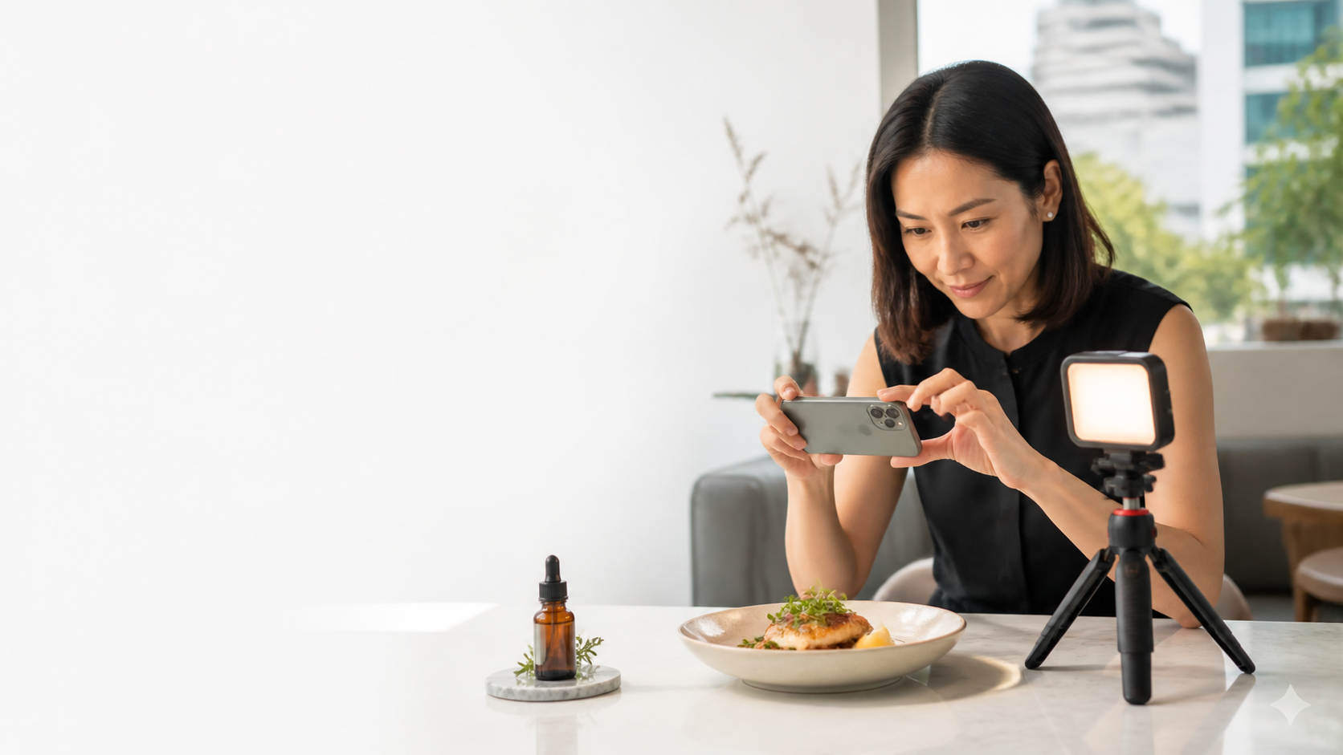
WSQ · CAMERA OPERATIONS
Master Mobile Photography: Capturing Professional Photos with Your Smartphone
Capture with intent · compose with purpose · edit with restraint
TGS-2026064718
Version v12.0 · 19 August 2026
Trainer: Dr Alfred Ang
Tertiary Infotech Academy Pte Ltd · UEN 201200696W

Slide 2
TRAQOM · SSG
Digital Attendance (Mandatory)
1
Take AM, PM and Assessment digital attendance for this WSQ-funded course.
2
The trainer or administrator displays the SSG attendance QR code.
3
Scan with Singpass/mobile camera and submit each required attendance.
4
At least 75% attendance and a Competent assessment outcome are required.
Master Mobile Photography · TGS-2026064718
© 2026 Tertiary Infotech Academy Pte Ltd
2

Slide 3
YOUR TRAINER · GENERAL
About the Trainer
NAME
________________________________________
?
TITLE / DESIGNATION
________________________________________
QUALIFICATIONS
________________________________________
AREAS OF EXPERTISE
________________________________________
Your Trainer
Complete before delivery
TRAINING EXPERIENCE
________________________________________
CONTACT
________________________________________
Master Mobile Photography · TGS-2026064718
© 2026 Tertiary Infotech Academy Pte Ltd
3

Slide 4
YOUR TRAINER
About the Trainer
ROLE
Principal Trainer and courseware lead
AA
EXPERTISE
AI, automation, software and visual learning design
DELIVERS
WSQ and professional digital-skills programmes
Dr Alfred Ang
Principal Trainer · Tertiary Infotech Academy
ORGANISATION
Tertiary Infotech Academy Pte Ltd
Master Mobile Photography · TGS-2026064718
© 2026 Tertiary Infotech Academy Pte Ltd
4

Slide 5
ICEBREAKER
Let's Know Each Other
1
Name, organisation and role
2
Your main photography use case
3
Phone model and camera experience
4
One result you want by the end of Day 2
Master Mobile Photography · TGS-2026064718
© 2026 Tertiary Infotech Academy Pte Ltd
5

Slide 6
HOUSEKEEPING
Ground Rules
1
Phone on silent except during guided capture
2
Participate actively and ask questions
3
Respect people, locations and differing views
4
One conversation at a time
Phone on silent except during guided capture
Participate actively and ask questions
Respect people, locations and differing views
One conversation at a time
5
Return from breaks punctually
6
Stop any activity that becomes unsafe
Return from breaks punctually
Stop any activity that becomes unsafe
Master Mobile Photography · TGS-2026064718
© 2026 Tertiary Infotech Academy Pte Ltd
6

Slide 7
COURSE AT A GLANCE
Course Profile
Programme
What to bring
1
2 days · 16 hours
1
Smartphone with camera
2
Beginner level
2
Optional laptop for file review
3
Camera Operations
3
Activities in individual folders
4
TSC MED-MPN-3034-1.1
4
WA and Practical Performance
Master Mobile Photography · TGS-2026064718
© 2026 Tertiary Infotech Academy Pte Ltd
7

Slide 8
SMARTPHONE IMAGING
How a Smartphone Builds an Image
Optics
Sensor
Computation
The lens and camera module set field of view, perspective and how much light reaches the sensor.
The sensor records light within physical limits such as noise, motion blur and dynamic range.
The phone aligns and merges frames, then applies tone, colour, sharpening and noise reduction.
Master Mobile Photography · TGS-2026064718
© 2026 Tertiary Infotech Academy Pte Ltd
8

Slide 9
WHAT YOU'LL ACHIEVE
Learning Outcomes
1
LO1
2
LO2
3
LO3
4
LO4
Set up a mobile phone camera for shooting and interpret a shot plan.
Perform basic mobile photography while meeting safety requirements.
Apply framing and composition techniques using a mobile phone camera.
Enhance visual quality and effects using capture and editing controls.
Master Mobile Photography · TGS-2026064718
© 2026 Tertiary Infotech Academy Pte Ltd
9

Slide 10
KNOWLEDGE K1–K8
Skills Framework Coverage
1
K1
2
K2
3
K3
4
K4
Technical specifications for camera equipment and accessories
Features and functions of camera equipment and accessories
Instructions for operating different cameras
Camera positions used to shoot and frame
5
K5
6
K6
7
K7
8
K8
Principles of picture composition
Cinematography techniques
Specialty camera equipment and accessories
Safety regulations and procedures for camera operations
Master Mobile Photography · TGS-2026064718
© 2026 Tertiary Infotech Academy Pte Ltd
10

Slide 11
ABILITIES A1–A7
Ability Coverage
1
A1
2
A2
3
A3
4
A4
Interpret detailed shot plans and technical requirements
Coordinate teams for mounted or complex shots
Inspect equipment for correct and safe fitting
Operate cameras to meet aesthetic requirements
5
A5
6
A6
7
A7
Control camera movement, framing and composition safely
Alter settings or equipment to compensate for variables
Provide feedback on angles and movement to improve visual effects
Master Mobile Photography · TGS-2026064718
© 2026 Tertiary Infotech Academy Pte Ltd
11

Slide 12
SCHEDULE
Lesson Plan — Day 1
Morning
Afternoon
1
09:00 Admin, outcomes and assessment briefing
1
13:00 Activity 2
2
09:45 Topic 1 concepts
2
14:00 Topic 2 concepts
3
11:20 Activity 1
3
16:00 Activities 3–4
4
12:15 Lunch
4
17:40 Review and Day 1 close
Master Mobile Photography · TGS-2026064718
© 2026 Tertiary Infotech Academy Pte Ltd
12

Slide 13
SCHEDULE
Lesson Plan — Day 2
Morning
Afternoon and assessment
1
09:00 Topic 3 concepts
1
14:00 Activities 7–8 and course review
2
10:30 Activities 5–6
2
15:00 Written Assessment · 90 min
3
12:15 Lunch
3
16:30 Practical Performance · 90 min
4
13:00 Topic 4 concepts
4
18:00 End of class
Master Mobile Photography · TGS-2026064718
© 2026 Tertiary Infotech Academy Pte Ltd
13

Slide 14
BEFORE ASSESSMENT
Briefing for Assessment
1
Individual, open-book work; no discussion
2
Use only the slides, Learner Guide and approved materials
3
No photographs or recordings of assessment scripts
4
Keep phones/materials under the table unless instructed
5
Submit on the LMS and sign the Assessment Summary Record
Master Mobile Photography · TGS-2026064718
© 2026 Tertiary Infotech Academy Pte Ltd
14

Slide 15
FINAL ASSESSMENT
Assessment and Funding
Knowledge
Ability
1
Written Assessment (SAQ)
1
Practical Performance
2
8 open-ended questions
2
3 integrated tasks
3
K1–K8
3
A1–A7
4
90 minutes
4
90 minutes
Master Mobile Photography · TGS-2026064718
© 2026 Tertiary Infotech Academy Pte Ltd
15

Slide 16
ON ASSESSMENT DAY
Assessment Flow
1
2
3
4
5
▶
▶
▶
▶
TRAQOM digital attendance
Assessment digital attendance
Sit WA then PP
Submit answers on LMS
Sign Assessment Summary Record
Master Mobile Photography · TGS-2026064718
© 2026 Tertiary Infotech Academy Pte Ltd
16

Slide 17
LEARNER MATERIALS
Access the Course Activities
Clone
Download
1
Open the course repository
1
Choose Code · Download ZIP
2
Copy the repository address
2
Extract the downloaded file
3
Open the activities folder
3
Each activity is self-contained
https://github.com/tertiarycourses/TGS-2026064718-Master-Mobile-Photography-Capturing-Professional-Photos-with-Your-Smartphone
Master Mobile Photography · TGS-2026064718
© 2026 Tertiary Infotech Academy Pte Ltd
17

Slide 18
DOWNLOAD COURSE MATERIAL
Courseware and Assessment on the LMS
1
Open the LMS/TMS portal
2
Download the learner slides and Learner Guide
3
Use the detailed activity procedures in the Learner Guide
4
Submit the two assessment instruments on the LMS
Master Mobile Photography · TGS-2026064718
© 2026 Tertiary Infotech Academy Pte Ltd
18

Slide 19
TOPIC 01
01
Setting Up a Mobile Camera for Shooting
Camera systems · accessories · inspection · shot planning · team coordination
Master Mobile Photography · TGS-2026064718
© 2026 Tertiary Infotech Academy Pte Ltd
19

Slide 20
K1 · K2 · A1 · A2 · A3 · PART 1
Topic 01 Roadmap
1
From Film to Computational Cameras
2
Inside a Smartphone Camera
3
Camera Types and Choosing Well
4
The Multi-Camera Phone
From Film to Computational Cameras
Inside a Smartphone Camera
Camera Types and Choosing Well
The Multi-Camera Phone
5
Fixed Aperture, Variable Decisions
6
File Formats and Resolution
7
Why Mobile Photography Works
8
Limits to Plan Around
Fixed Aperture, Variable Decisions
File Formats and Resolution
Why Mobile Photography Works
Limits to Plan Around
Master Mobile Photography · TGS-2026064718
© 2026 Tertiary Infotech Academy Pte Ltd
20

Slide 21
K1 · K2 · A1 · A2 · A3 · PART 2
Topic 01 Roadmap
1
Stability Accessories
2
Optical and Lighting Accessories
3
Accessory Selection Matrix
Stability Accessories
Optical and Lighting Accessories
Accessory Selection Matrix
4
The Pre-Shoot Inspection
5
Safe Camera Handling
6
Anatomy of a Shot Plan
The Pre-Shoot Inspection
Safe Camera Handling
Anatomy of a Shot Plan
7
Translate a Brief into Pictures
8
Coordinate a Mounted Shot
9
Privacy, Property and Consent
Translate a Brief into Pictures
Coordinate a Mounted Shot
Privacy, Property and Consent
Master Mobile Photography · TGS-2026064718
© 2026 Tertiary Infotech Academy Pte Ltd
21

Slide 22
TOPIC 01 · K1 · K2 · A1 · A2 · A3
From Film to Computational Cameras
1
35 mm film records light chemically
2
Digital cameras record light on a sensor
3
Smartphones combine optics, sensor and algorithms
4
The useful question is fitness for purpose—not status
35 mm film records light chemically
Digital cameras record light on a sensor
Smartphones combine optics, sensor and algorithms
The useful question is fitness for purpose—not status
Master Mobile Photography · TGS-2026064718
© 2026 Tertiary Infotech Academy Pte Ltd
22

Slide 23
TOPIC 01 · CONCEPT
Inside a Smartphone Camera
1
2
3
4
▶
▶
▶
Lens gathers and directs light
Sensor converts light into electrical data
Image processor reduces noise and builds colour
Computational capture may merge several frames
Master Mobile Photography · TGS-2026064718
© 2026 Tertiary Infotech Academy Pte Ltd
23

Slide 24
TOPIC 01 · K1 · K2 · A1 · A2 · A3
Camera Types and Choosing Well
1
Film
2
Dedicated digital
3
Mobile
4
Choose by purpose, budget, speed and acceptable quality
tactile process and finite frames
larger controls and system lenses
always available, connected and discreet
Choose by purpose, budget, speed and acceptable quality
Master Mobile Photography · TGS-2026064718
© 2026 Tertiary Infotech Academy Pte Ltd
24

Slide 25
TOPIC 01 · K1 · K2 · A1 · A2 · A3
The Multi-Camera Phone
1
Ultra-wide expands the field of view
2
Wide/main camera is usually the strongest all-rounder
3
Telephoto changes framing without walking closer
4
Macro/depth/periscope modules vary by device
Ultra-wide expands the field of view
Wide/main camera is usually the strongest all-rounder
Telephoto changes framing without walking closer
Macro/depth/periscope modules vary by device
Master Mobile Photography · TGS-2026064718
© 2026 Tertiary Infotech Academy Pte Ltd
25

Slide 26
TOPIC 01 · K1 · K2 · A1 · A2 · A3
Fixed Aperture, Variable Decisions
1
Most phone lenses use a fixed physical aperture
2
Shutter time and ISO remain key exposure controls
3
Portrait blur is often computed from depth data
4
Do not promise an aperture control a phone does not have
Most phone lenses use a fixed physical aperture
Shutter time and ISO remain key exposure controls
Portrait blur is often computed from depth data
Do not promise an aperture control a phone does not have
Master Mobile Photography · TGS-2026064718
© 2026 Tertiary Infotech Academy Pte Ltd
26

Slide 27
TOPIC 01 · K1 · K2 · A1 · A2 · A3
File Formats and Resolution
1
JPEG/HEIF are processed and compact
2
RAW preserves more adjustment latitude
3
Higher resolution gives crop room but uses storage
4
Select format and aspect ratio for the final channel
JPEG/HEIF are processed and compact
RAW preserves more adjustment latitude
Higher resolution gives crop room but uses storage
Select format and aspect ratio for the final channel
Master Mobile Photography · TGS-2026064718
© 2026 Tertiary Infotech Academy Pte Ltd
27

Slide 28
TOPIC 01 · K1 · K2 · A1 · A2 · A3
Why Mobile Photography Works
1
The camera is already with you
2
Capture, edit and share on one device
3
Small size supports candid and low-profile work
4
Accessories cost less than a full camera system
The camera is already with you
Capture, edit and share on one device
Small size supports candid and low-profile work
Accessories cost less than a full camera system
Master Mobile Photography · TGS-2026064718
© 2026 Tertiary Infotech Academy Pte Ltd
28

Slide 29
TOPIC 01 · K1 · K2 · A1 · A2 · A3
Limits to Plan Around
1
Small sensors struggle when light is scarce
2
Digital zoom removes pixels
3
Tiny lenses exaggerate flare and smudges
4
Automation can misread focus, colour or depth
Small sensors struggle when light is scarce
Digital zoom removes pixels
Tiny lenses exaggerate flare and smudges
Automation can misread focus, colour or depth
Master Mobile Photography · TGS-2026064718
© 2026 Tertiary Infotech Academy Pte Ltd
29

Slide 30
TOPIC 01 · K1 · K2 · A1 · A2 · A3
Stability Accessories
1
Two-handed grip reduces shake
2
Tripod supports low light, panorama and repeatable framing
3
Bluetooth or timer release avoids touch vibration
4
A clamp must fit the phone and tighten securely
Two-handed grip reduces shake
Tripod supports low light, panorama and repeatable framing
Bluetooth or timer release avoids touch vibration
A clamp must fit the phone and tighten securely
Master Mobile Photography · TGS-2026064718
© 2026 Tertiary Infotech Academy Pte Ltd
30

Slide 31
TOPIC 01 · K1 · K2 · A1 · A2 · A3
Optical and Lighting Accessories
1
Clip-on lenses must align with the correct module
2
Filters can control glare or incoming light
3
LED panels provide continuous, directional light
4
A power bank protects a long assignment
Clip-on lenses must align with the correct module
Filters can control glare or incoming light
LED panels provide continuous, directional light
A power bank protects a long assignment
Master Mobile Photography · TGS-2026064718
© 2026 Tertiary Infotech Academy Pte Ltd
31

Slide 32
TOPIC 01 · K1 · K2 · A1 · A2 · A3
Accessory Selection Matrix
1
Need
2
Fit
3
Quality
4
Safety
solve a real capture problem
verify model, clamp and load compatibility
check sharpness, flare and build
inspect edges, joints, heat and cables
Master Mobile Photography · TGS-2026064718
© 2026 Tertiary Infotech Academy Pte Ltd
32

Slide 33
TOPIC 01 · CONCEPT
The Pre-Shoot Inspection
1
2
3
4
▶
▶
▶
Clean all active lenses with a microfibre cloth
Check battery, storage and chosen format
Test tripod locks, clamp, remote and light
Record defects and remove unsafe equipment
Master Mobile Photography · TGS-2026064718
© 2026 Tertiary Infotech Academy Pte Ltd
33

Slide 34
TOPIC 01 · K1 · K2 · A1 · A2 · A3
Safe Camera Handling
1
Keep fingers clear of lenses
2
Stand balanced and stop before composing
3
Use a wrist strap where a drop could injure
4
Never step backward into traffic or hazards
Keep fingers clear of lenses
Stand balanced and stop before composing
Use a wrist strap where a drop could injure
Never step backward into traffic or hazards
Master Mobile Photography · TGS-2026064718
© 2026 Tertiary Infotech Academy Pte Ltd
34

Slide 35
TOPIC 01 · K1 · K2 · A1 · A2 · A3
Anatomy of a Shot Plan
1
Objective and audience
2
Subject, location and production style
3
Shot list with size, angle and composition
4
Light, settings, equipment, safety and permissions
Objective and audience
Subject, location and production style
Shot list with size, angle and composition
Light, settings, equipment, safety and permissions
Master Mobile Photography · TGS-2026064718
© 2026 Tertiary Infotech Academy Pte Ltd
35

Slide 36
TOPIC 01 · CONCEPT
Translate a Brief into Pictures
1
2
3
4
▶
▶
▶
Identify the message the client needs
Select a visual style that supports it
Turn deliverables into observable shot requirements
Define acceptance criteria before capture
Master Mobile Photography · TGS-2026064718
© 2026 Tertiary Infotech Academy Pte Ltd
36

Slide 37
TOPIC 01 · K1 · K2 · A1 · A2 · A3
Coordinate a Mounted Shot
1
Agree roles and a clear call sequence
2
Mark the tripod footprint away from public flow
3
Confirm horizon, sweep direction and start/end points
4
Stop when people enter the operating zone
Agree roles and a clear call sequence
Mark the tripod footprint away from public flow
Confirm horizon, sweep direction and start/end points
Stop when people enter the operating zone
Master Mobile Photography · TGS-2026064718
© 2026 Tertiary Infotech Academy Pte Ltd
37

Slide 38
TOPIC 01 · K1 · K2 · A1 · A2 · A3
Privacy, Property and Consent
1
Ask permission for identifiable people
2
Avoid confidential screens, documents and badges
3
Respect property rules and restricted locations
4
Do not publish logos or faces without authority
Ask permission for identifiable people
Avoid confidential screens, documents and badges
Respect property rules and restricted locations
Do not publish logos or faces without authority
Master Mobile Photography · TGS-2026064718
© 2026 Tertiary Infotech Academy Pte Ltd
38

Slide 39
TOPIC 01 · REAL-USE-CASE ACTIVITY
Plan and Inspect a Café Product Shoot
ACTIVITY 1
A neighbourhood café needs eight smartphone photographs of a signature dish and wellness product for a launch post.
YOU'LL PRODUCE
Approved shot plan, equipment inspection, safety check and two test frames
Full procedures: Learner Guide and Activity folder
A1 · A3 · Smartphone, microfibre cloth, tabletop tripod, LED panel, reflector, power bank
Master Mobile Photography · TGS-2026064718
© 2026 Tertiary Infotech Academy Pte Ltd
39

Slide 40
ACTIVITY 1 · ANALYSE BEFORE CAPTURE
Visual Brief and Reference
1
What attracts attention first?
2
Which light, angle and composition choices are visible?
3
What could fail technically or ethically?
4
Which acceptance criterion does the image demonstrate?
Master Mobile Photography · TGS-2026064718
© 2026 Tertiary Infotech Academy Pte Ltd
40

Slide 41
ACTIVITY 1 · VERIFY
Acceptance Review
✓
All eight shots map to a clear purpose
✓
Inspection checklist is complete
✓
No unsafe equipment remains in use
✓
Test frames meet focus and highlight criteria
Evidence: final images · completed checklist · settings/decision log · peer feedback
Master Mobile Photography · TGS-2026064718
© 2026 Tertiary Infotech Academy Pte Ltd
41

Slide 42
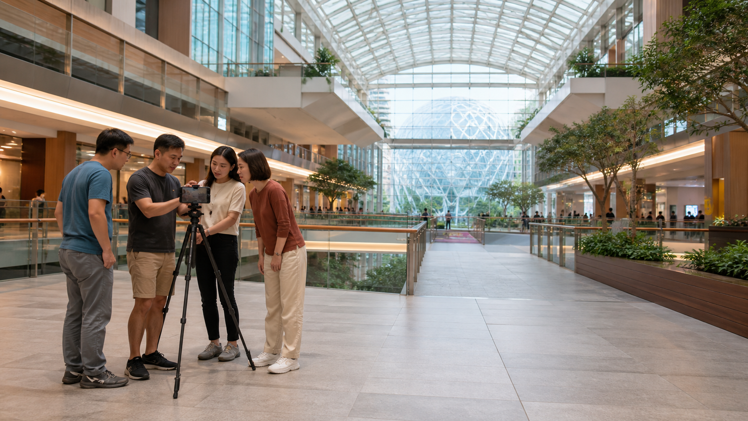
TOPIC 01 · REAL-USE-CASE ACTIVITY
Coordinate a Safe Retail Panorama
ACTIVITY 2
A retail centre needs a clean panorama and supporting wide photographs showing an atrium without obstructing public movement.
YOU'LL PRODUCE
Role call sheet, safe tripod setup, panorama and two supporting wide shots
Full procedures: Learner Guide and Activity folder
A2 · A4 · Smartphone, tripod and clamp, Bluetooth remote, floor markers
Master Mobile Photography · TGS-2026064718
© 2026 Tertiary Infotech Academy Pte Ltd
42

Slide 43
ACTIVITY 2 · ANALYSE BEFORE CAPTURE
Visual Brief and Reference
1
What attracts attention first?
2
Which light, angle and composition choices are visible?
3
What could fail technically or ethically?
4
Which acceptance criterion does the image demonstrate?
Master Mobile Photography · TGS-2026064718
© 2026 Tertiary Infotech Academy Pte Ltd
43

Slide 44
ACTIVITY 2 · VERIFY
Acceptance Review
✓
Roles and stop signals are documented
✓
Tripod is stable and non-obstructive
✓
Panorama has a level horizon and clean seams
✓
Supporting shots meet the aesthetic brief
Evidence: final images · completed checklist · settings/decision log · peer feedback
Master Mobile Photography · TGS-2026064718
© 2026 Tertiary Infotech Academy Pte Ltd
44

Slide 45
CHECK YOUR UNDERSTANDING
Topic 01 Recap
1
Explain
2
Explain
3
Explain
4
Explain
Anatomy of a Shot Plan
Translate a Brief into Pictures
Coordinate a Mounted Shot
Privacy, Property and Consent
Master Mobile Photography · TGS-2026064718
© 2026 Tertiary Infotech Academy Pte Ltd
45

Slide 46
Lunch Break
45 minutes
Master Mobile Photography · TGS-2026064718
© 2026 Tertiary Infotech Academy Pte Ltd
46

Slide 47
TOPIC 02
02
Basic Mobile Photography Skills
Exposure · focus · colour · light · lenses · low-light and motion control
Master Mobile Photography · TGS-2026064718
© 2026 Tertiary Infotech Academy Pte Ltd
47

Slide 48
K3 · K8 · A3 · A4 · A6 · PART 1
Topic 02 Roadmap
1
Exposure Is a Creative Choice
2
The Exposure Triangle—Adapted for Phones
3
Shutter Time and Motion
4
ISO and Image Quality
Exposure Is a Creative Choice
The Exposure Triangle—Adapted for Phones
Shutter Time and Motion
ISO and Image Quality
5
Tap Focus and Focus Lock
6
Exposure Compensation and AE Lock
7
White Balance and Colour Temperature
8
HDR and Dynamic Range
Tap Focus and Focus Lock
Exposure Compensation and AE Lock
White Balance and Colour Temperature
HDR and Dynamic Range
Master Mobile Photography · TGS-2026064718
© 2026 Tertiary Infotech Academy Pte Ltd
48

Slide 49
K3 · K8 · A3 · A4 · A6 · PART 2
Topic 02 Roadmap
1
Optical vs Digital Zoom
2
Perspective and Compression
3
Read the Direction of Light
Optical vs Digital Zoom
Perspective and Compression
Read the Direction of Light
4
Soft, Hard and Available Light
5
Golden Hour, Blue Hour and Midday
6
Night and Low-Light Strategy
Soft, Hard and Available Light
Golden Hour, Blue Hour and Midday
Night and Low-Light Strategy
7
Burst, Panorama and Portrait Modes
8
Flash
9
A Clean Capture Routine
Burst, Panorama and Portrait Modes
Use with Intent
A Clean Capture Routine
Master Mobile Photography · TGS-2026064718
© 2026 Tertiary Infotech Academy Pte Ltd
49

Slide 50
TOPIC 02 · K3 · K8 · A3 · A4 · A6
Exposure Is a Creative Choice
1
Protect important highlight detail
2
Keep the subject bright enough to read
3
Accept or suppress shadow detail deliberately
4
Use brightness to support mood
Protect important highlight detail
Keep the subject bright enough to read
Accept or suppress shadow detail deliberately
Use brightness to support mood
Master Mobile Photography · TGS-2026064718
© 2026 Tertiary Infotech Academy Pte Ltd
50

Slide 51
TOPIC 02 · K3 · K8 · A3 · A4 · A6
The Exposure Triangle—Adapted for Phones
1
Shutter time controls motion and incoming light
2
ISO amplifies the sensor signal and noise
3
Aperture is normally fixed on the phone module
4
Automation and multi-frame processing share the workload
Shutter time controls motion and incoming light
ISO amplifies the sensor signal and noise
Aperture is normally fixed on the phone module
Automation and multi-frame processing share the workload
Master Mobile Photography · TGS-2026064718
© 2026 Tertiary Infotech Academy Pte Ltd
51

Slide 52
TOPIC 02 · K3 · K8 · A3 · A4 · A6
Shutter Time and Motion
1
Fast capture freezes action
2
Slow capture records motion as blur
3
Panning follows a moving subject
4
Long exposure needs stability and a controlled scene
Fast capture freezes action
Slow capture records motion as blur
Panning follows a moving subject
Long exposure needs stability and a controlled scene
Master Mobile Photography · TGS-2026064718
© 2026 Tertiary Infotech Academy Pte Ltd
52

Slide 53
TOPIC 02 · K3 · K8 · A3 · A4 · A6
ISO and Image Quality
1
Low ISO generally gives cleaner detail
2
Higher ISO helps in low light but adds noise
3
Stabilise before raising ISO unnecessarily
4
Judge the result at useful viewing size
Low ISO generally gives cleaner detail
Higher ISO helps in low light but adds noise
Stabilise before raising ISO unnecessarily
Judge the result at useful viewing size
Master Mobile Photography · TGS-2026064718
© 2026 Tertiary Infotech Academy Pte Ltd
53

Slide 54
TOPIC 02 · K3 · K8 · A3 · A4 · A6
Tap Focus and Focus Lock
1
Place focus on the intended subject
2
Check eyes for portraits and detail for products
3
Lock focus when recomposing or waiting for action
4
Re-focus if subject distance changes
Place focus on the intended subject
Check eyes for portraits and detail for products
Lock focus when recomposing or waiting for action
Re-focus if subject distance changes
Master Mobile Photography · TGS-2026064718
© 2026 Tertiary Infotech Academy Pte Ltd
54

Slide 55
TOPIC 02 · CONCEPT
Exposure Compensation and AE Lock
1
2
3
4
▶
▶
▶
Tap the subject or priority tone
Move the brightness control up or down
Lock exposure for a consistent sequence
Review highlights and re-adjust before capture
Master Mobile Photography · TGS-2026064718
© 2026 Tertiary Infotech Academy Pte Ltd
55

Slide 56
TOPIC 02 · K3 · K8 · A3 · A4 · A6
White Balance and Colour Temperature
1
Warm light shifts toward amber
2
Cool light shifts toward blue
3
Auto white balance may change between frames
4
Set a preset or manual value for consistency
Warm light shifts toward amber
Cool light shifts toward blue
Auto white balance may change between frames
Set a preset or manual value for consistency
Master Mobile Photography · TGS-2026064718
© 2026 Tertiary Infotech Academy Pte Ltd
56

Slide 57
TOPIC 02 · K3 · K8 · A3 · A4 · A6
HDR and Dynamic Range
1
High-contrast scenes exceed one exposure
2
HDR blends frames for shadow and highlight detail
3
Movement can cause ghosting
4
Keep the phone steady and inspect edges
High-contrast scenes exceed one exposure
HDR blends frames for shadow and highlight detail
Movement can cause ghosting
Keep the phone steady and inspect edges
Master Mobile Photography · TGS-2026064718
© 2026 Tertiary Infotech Academy Pte Ltd
57

Slide 58
TOPIC 02 · K3 · K8 · A3 · A4 · A6
Optical vs Digital Zoom
1
Optical steps use another physical camera
2
Digital zoom crops and enlarges pixels
3
Move closer when it is safe
4
Crop later when composition allows
Optical steps use another physical camera
Digital zoom crops and enlarges pixels
Move closer when it is safe
Crop later when composition allows
Master Mobile Photography · TGS-2026064718
© 2026 Tertiary Infotech Academy Pte Ltd
58

Slide 59
TOPIC 02 · K3 · K8 · A3 · A4 · A6
Perspective and Compression
1
Camera position controls perspective
2
Close wide-angle views exaggerate near objects
3
Farther tele views appear more compressed
4
Choose position first, then lens
Camera position controls perspective
Close wide-angle views exaggerate near objects
Farther tele views appear more compressed
Choose position first, then lens
Master Mobile Photography · TGS-2026064718
© 2026 Tertiary Infotech Academy Pte Ltd
59

Slide 60
TOPIC 02 · K3 · K8 · A3 · A4 · A6
Read the Direction of Light
1
Front light reveals detail
2
Side light models form and texture
3
Backlight creates rim light or silhouette
4
Top light can deepen eye and nose shadows
Front light reveals detail
Side light models form and texture
Backlight creates rim light or silhouette
Top light can deepen eye and nose shadows
Master Mobile Photography · TGS-2026064718
© 2026 Tertiary Infotech Academy Pte Ltd
60

Slide 61
TOPIC 02 · K3 · K8 · A3 · A4 · A6
Soft, Hard and Available Light
1
Large close sources create softer transitions
2
Small or distant sources make hard edges
3
Window light is an efficient soft source
4
Use reflectors or white surfaces before flash
Large close sources create softer transitions
Small or distant sources make hard edges
Window light is an efficient soft source
Use reflectors or white surfaces before flash
Master Mobile Photography · TGS-2026064718
© 2026 Tertiary Infotech Academy Pte Ltd
61

Slide 62
TOPIC 02 · K3 · K8 · A3 · A4 · A6
Golden Hour, Blue Hour and Midday
1
Golden hour gives warm directional light
2
Blue hour balances sky and city lights
3
Midday produces hard shadows and bright highlights
4
Match the time of day to the intended mood
Golden hour gives warm directional light
Blue hour balances sky and city lights
Midday produces hard shadows and bright highlights
Match the time of day to the intended mood
Master Mobile Photography · TGS-2026064718
© 2026 Tertiary Infotech Academy Pte Ltd
62

Slide 63
TOPIC 02 · CONCEPT
Night and Low-Light Strategy
1
2
3
4
▶
▶
▶
Clean the lens
Use night mode or a stable support
Lower exposure to protect bright lamps
Use available light and expect some texture/noise
Master Mobile Photography · TGS-2026064718
© 2026 Tertiary Infotech Academy Pte Ltd
63

Slide 64
TOPIC 02 · K3 · K8 · A3 · A4 · A6
Burst, Panorama and Portrait Modes
1
Burst improves timing for action
2
Panorama stitches a controlled sweep
3
Portrait mode estimates subject separation
4
Review seams, edges and depth errors
Burst improves timing for action
Panorama stitches a controlled sweep
Portrait mode estimates subject separation
Review seams, edges and depth errors
Master Mobile Photography · TGS-2026064718
© 2026 Tertiary Infotech Academy Pte Ltd
64

Slide 65
TOPIC 02 · K3 · K8 · A3 · A4 · A6
Flash: Use with Intent
1
On-phone flash is small and near the lens
2
It can flatten faces and create hard reflections
3
Prefer window, ambient or off-axis LED light
4
Use flash only when its look solves the brief
On-phone flash is small and near the lens
It can flatten faces and create hard reflections
Prefer window, ambient or off-axis LED light
Use flash only when its look solves the brief
Master Mobile Photography · TGS-2026064718
© 2026 Tertiary Infotech Academy Pte Ltd
65

Slide 66
TOPIC 02 · CONCEPT
A Clean Capture Routine
1
2
3
4
▶
▶
▶
Clean · stabilise · frame
Focus · set brightness · lock if needed
Capture a short variation set
Review sharpness, highlights and distractions
Master Mobile Photography · TGS-2026064718
© 2026 Tertiary Infotech Academy Pte Ltd
66

Slide 67

TOPIC 02 · REAL-USE-CASE ACTIVITY
Control Exposure and Colour at a Corporate Event
ACTIVITY 3
An event organiser needs speaker and audience photographs under mixed warm stage light and cool ambient light.
YOU'LL PRODUCE
Exposure/focus test set, white-balance comparison and five usable event frames
Full procedures: Learner Guide and Activity folder
A4 · A6 · Smartphone with Pro/Manual mode or exposure compensation, optional monopod
Master Mobile Photography · TGS-2026064718
© 2026 Tertiary Infotech Academy Pte Ltd
67

Slide 68
ACTIVITY 3 · ANALYSE BEFORE CAPTURE
Visual Brief and Reference
1
What attracts attention first?
2
Which light, angle and composition choices are visible?
3
What could fail technically or ethically?
4
Which acceptance criterion does the image demonstrate?
Master Mobile Photography · TGS-2026064718
© 2026 Tertiary Infotech Academy Pte Ltd
68

Slide 69
ACTIVITY 3 · VERIFY
Acceptance Review
✓
Faces are sharp and readable
✓
Important highlights are not clipped
✓
White balance is consistent across the sequence
✓
Five frames cover place, action and reaction
Evidence: final images · completed checklist · settings/decision log · peer feedback
Master Mobile Photography · TGS-2026064718
© 2026 Tertiary Infotech Academy Pte Ltd
69

Slide 70
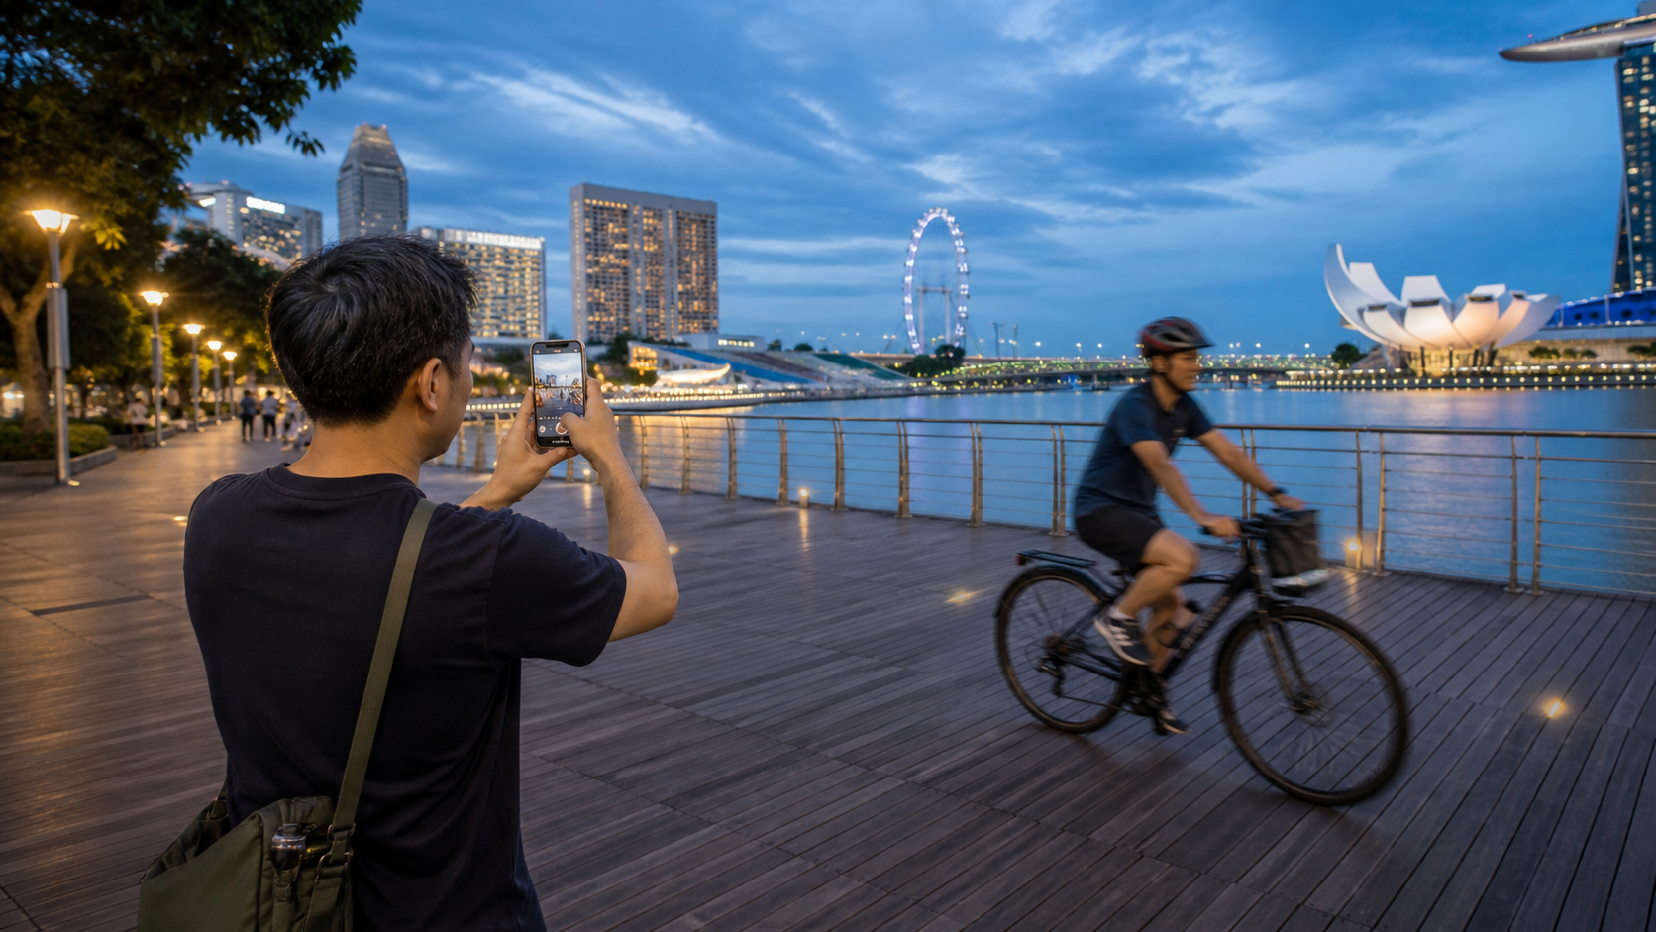
TOPIC 02 · REAL-USE-CASE ACTIVITY
Freeze and Blur Motion at Blue Hour
ACTIVITY 4
A city mobility campaign needs one frozen-action frame and one creative motion frame from a safe waterfront location.
YOU'LL PRODUCE
Frozen-action image, panning image, low-light comparison and settings log
Full procedures: Learner Guide and Activity folder
A4 · A5 · A6 · Smartphone with burst/manual controls, tripod or stable support, Bluetooth remote
Master Mobile Photography · TGS-2026064718
© 2026 Tertiary Infotech Academy Pte Ltd
70

Slide 71
ACTIVITY 4 · ANALYSE BEFORE CAPTURE
Visual Brief and Reference
1
What attracts attention first?
2
Which light, angle and composition choices are visible?
3
What could fail technically or ethically?
4
Which acceptance criterion does the image demonstrate?
Master Mobile Photography · TGS-2026064718
© 2026 Tertiary Infotech Academy Pte Ltd
71

Slide 72
ACTIVITY 4 · VERIFY
Acceptance Review
✓
Capture position is safe
✓
Frozen frame has a readable subject
✓
Panning frame communicates motion
✓
Settings/effect relationship is explained
Evidence: final images · completed checklist · settings/decision log · peer feedback
Master Mobile Photography · TGS-2026064718
© 2026 Tertiary Infotech Academy Pte Ltd
72

Slide 73
CHECK YOUR UNDERSTANDING
Topic 02 Recap
1
Explain
2
Explain
3
Explain
4
Explain
Night and Low-Light Strategy
Burst, Panorama and Portrait Modes
Flash: Use with Intent
A Clean Capture Routine
Master Mobile Photography · TGS-2026064718
© 2026 Tertiary Infotech Academy Pte Ltd
73

Slide 74
End of Day 1
Return refreshed for composition and creative capture
Master Mobile Photography · TGS-2026064718
© 2026 Tertiary Infotech Academy Pte Ltd
74

Slide 75
TOPIC 03
03
Framing and Composition
Visual hierarchy · placement · lines · space · depth · patterns · emotive arrangement
Master Mobile Photography · TGS-2026064718
© 2026 Tertiary Infotech Academy Pte Ltd
75

Slide 76
K4 · K5 · A5 · PART 1
Topic 03 Roadmap
1
Composition Directs Attention
2
Rule of Thirds
3
When Centre Composition Works
4
Balance and Symmetry
Composition Directs Attention
Rule of Thirds
When Centre Composition Works
Balance and Symmetry
5
Pattern, Proportion, Rhythm and Unity
6
Negative Space
7
Leading Lines
8
Frame Within a Frame
Pattern, Proportion, Rhythm and Unity
Negative Space
Leading Lines
Frame Within a Frame
Master Mobile Photography · TGS-2026064718
© 2026 Tertiary Infotech Academy Pte Ltd
76

Slide 77
K4 · K5 · A5 · PART 2
Topic 03 Roadmap
1
Patterns, Texture and Repetition
2
Contrast Creates Separation
3
Reflections and Visual Effects
Patterns, Texture and Repetition
Contrast Creates Separation
Reflections and Visual Effects
4
Scale and Depth
5
Rule of Space
6
Point of View
Scale and Depth
Rule of Space
Point of View
7
Arrange Subjects for Emotion
8
The Blank-Canvas Check
9
Orientation, Crop and Aspect Ratio
Arrange Subjects for Emotion
The Blank-Canvas Check
Orientation, Crop and Aspect Ratio
Master Mobile Photography · TGS-2026064718
© 2026 Tertiary Infotech Academy Pte Ltd
77

Slide 78
TOPIC 03 · K4 · K5 · A5
Composition Directs Attention
1
Choose one primary subject
2
Remove elements that compete
3
Use placement, scale and contrast to guide the eye
4
The frame includes everything—wanted or not
Choose one primary subject
Remove elements that compete
Use placement, scale and contrast to guide the eye
The frame includes everything—wanted or not
Master Mobile Photography · TGS-2026064718
© 2026 Tertiary Infotech Academy Pte Ltd
78

Slide 79
TOPIC 03 · K4 · K5 · A5
Rule of Thirds
1
Divide the frame into a three-by-three grid
2
Place key subjects near intersections
3
Align important horizons with a third
4
Leave space toward a gaze or movement
Divide the frame into a three-by-three grid
Place key subjects near intersections
Align important horizons with a third
Leave space toward a gaze or movement
Master Mobile Photography · TGS-2026064718
© 2026 Tertiary Infotech Academy Pte Ltd
79

Slide 80
TOPIC 03 · K4 · K5 · A5
When Centre Composition Works
1
Symmetrical architecture
2
Strong faces and direct gaze
3
Graphic shapes and isolated subjects
4
Use deliberate balance—not automatic centring
Symmetrical architecture
Strong faces and direct gaze
Graphic shapes and isolated subjects
Use deliberate balance—not automatic centring
Master Mobile Photography · TGS-2026064718
© 2026 Tertiary Infotech Academy Pte Ltd
80

Slide 81
TOPIC 03 · K4 · K5 · A5
Balance and Symmetry
1
Symmetry can be vertical, horizontal or radial
2
Visual weight includes brightness, colour and size
3
Asymmetrical balance feels dynamic
4
Minor imperfection can keep symmetry human
Symmetry can be vertical, horizontal or radial
Visual weight includes brightness, colour and size
Asymmetrical balance feels dynamic
Minor imperfection can keep symmetry human
Master Mobile Photography · TGS-2026064718
© 2026 Tertiary Infotech Academy Pte Ltd
81

Slide 82
TOPIC 03 · K4 · K5 · A5
Pattern, Proportion, Rhythm and Unity
1
Pattern repeats form or colour
2
Proportion compares visual sizes
3
Rhythm controls the repeated path of the eye
4
Unity makes separate elements feel intentional
Pattern repeats form or colour
Proportion compares visual sizes
Rhythm controls the repeated path of the eye
Unity makes separate elements feel intentional
Master Mobile Photography · TGS-2026064718
© 2026 Tertiary Infotech Academy Pte Ltd
82

Slide 83
TOPIC 03 · K4 · K5 · A5
Negative Space
1
Give the subject room to stand out
2
Choose a simple area with low detail
3
Use empty space for mood or copy
4
Do not confuse empty with accidental
Give the subject room to stand out
Choose a simple area with low detail
Use empty space for mood or copy
Do not confuse empty with accidental
Master Mobile Photography · TGS-2026064718
© 2026 Tertiary Infotech Academy Pte Ltd
83

Slide 84
TOPIC 03 · K4 · K5 · A5
Leading Lines
1
Roads, rails, shadows and edges can guide the eye
2
Enter the frame cleanly
3
Aim toward the subject or story point
4
Avoid lines that lead viewers out
Roads, rails, shadows and edges can guide the eye
Enter the frame cleanly
Aim toward the subject or story point
Avoid lines that lead viewers out
Master Mobile Photography · TGS-2026064718
© 2026 Tertiary Infotech Academy Pte Ltd
84

Slide 85
TOPIC 03 · K4 · K5 · A5
Frame Within a Frame
1
Use doors, windows, branches or foreground shapes
2
The inner frame concentrates attention
3
Keep the frame relevant to the setting
4
Do not cover important subject detail
Use doors, windows, branches or foreground shapes
The inner frame concentrates attention
Keep the frame relevant to the setting
Do not cover important subject detail
Master Mobile Photography · TGS-2026064718
© 2026 Tertiary Infotech Academy Pte Ltd
85

Slide 86
TOPIC 03 · K4 · K5 · A5
Patterns, Texture and Repetition
1
Fill the frame to strengthen rhythm
2
Break a pattern with one contrasting subject
3
Side light reveals texture
4
Repetition may be natural or arranged
Fill the frame to strengthen rhythm
Break a pattern with one contrasting subject
Side light reveals texture
Repetition may be natural or arranged
Master Mobile Photography · TGS-2026064718
© 2026 Tertiary Infotech Academy Pte Ltd
86

Slide 87
TOPIC 03 · K4 · K5 · A5
Contrast Creates Separation
1
Tonal
2
Colour
3
Scale
4
Concept
light against dark
warm against cool or complementary hues
large against small
old against new, still against moving
Master Mobile Photography · TGS-2026064718
© 2026 Tertiary Infotech Academy Pte Ltd
87

Slide 88
TOPIC 03 · K4 · K5 · A5
Reflections and Visual Effects
1
Use water, glass or polished metal
2
Control angle to keep or remove reflections
3
Symmetry can strengthen a mirrored scene
4
Check for unwanted photographer reflections
Use water, glass or polished metal
Control angle to keep or remove reflections
Symmetry can strengthen a mirrored scene
Check for unwanted photographer reflections
Master Mobile Photography · TGS-2026064718
© 2026 Tertiary Infotech Academy Pte Ltd
88

Slide 89
TOPIC 03 · K4 · K5 · A5
Scale and Depth
1
Include a known-size reference
2
Layer foreground, midground and background
3
Overlap creates depth
4
Perspective and focus can separate planes
Include a known-size reference
Layer foreground, midground and background
Overlap creates depth
Perspective and focus can separate planes
Master Mobile Photography · TGS-2026064718
© 2026 Tertiary Infotech Academy Pte Ltd
89

Slide 90
TOPIC 03 · K4 · K5 · A5
Rule of Space
1
Leave room in front of a moving subject
2
Leave looking room in portraits
3
Tight space can communicate pressure
4
Match the space to the emotional intent
Leave room in front of a moving subject
Leave looking room in portraits
Tight space can communicate pressure
Match the space to the emotional intent
Master Mobile Photography · TGS-2026064718
© 2026 Tertiary Infotech Academy Pte Ltd
90

Slide 91
TOPIC 03 · K4 · K5 · A5
Point of View
1
Eye level feels neutral and relational
2
High angle can reveal layout or reduce dominance
3
Low angle can add presence
4
Bird's-eye and worm's-eye views reshape context
Eye level feels neutral and relational
High angle can reveal layout or reduce dominance
Low angle can add presence
Bird's-eye and worm's-eye views reshape context
Master Mobile Photography · TGS-2026064718
© 2026 Tertiary Infotech Academy Pte Ltd
91

Slide 92
TOPIC 03 · K4 · K5 · A5
Arrange Subjects for Emotion
1
Distance can imply connection or isolation
2
Body direction creates relationships
3
Eye lines connect people and objects
4
Natural gestures read more credibly than rigid poses
Distance can imply connection or isolation
Body direction creates relationships
Eye lines connect people and objects
Natural gestures read more credibly than rigid poses
Master Mobile Photography · TGS-2026064718
© 2026 Tertiary Infotech Academy Pte Ltd
92

Slide 93
TOPIC 03 · CONCEPT
The Blank-Canvas Check
1
2
3
4
▶
▶
▶
Scan every edge and corner
Move yourself before moving the subject
Simplify backgrounds and merge lines carefully
Make every object earn its place
Master Mobile Photography · TGS-2026064718
© 2026 Tertiary Infotech Academy Pte Ltd
93

Slide 94
TOPIC 03 · K4 · K5 · A5
Orientation, Crop and Aspect Ratio
1
Portrait suits people and vertical channels
2
Landscape suits environments and groups
3
Square is graphic but removes side context
4
Capture with the final use in mind
Portrait suits people and vertical channels
Landscape suits environments and groups
Square is graphic but removes side context
Capture with the final use in mind
Master Mobile Photography · TGS-2026064718
© 2026 Tertiary Infotech Academy Pte Ltd
94

Slide 95

TOPIC 03 · REAL-USE-CASE ACTIVITY
Complete a Composition Photo Walk
ACTIVITY 5
A design studio needs a visual library of textures and urban details for a Singapore-themed mood board.
YOU'LL PRODUCE
Ten-image contact sheet demonstrating ten named composition techniques
Full procedures: Learner Guide and Activity folder
A5 · Smartphone, grid overlay, optional macro attachment
Master Mobile Photography · TGS-2026064718
© 2026 Tertiary Infotech Academy Pte Ltd
95

Slide 96
ACTIVITY 5 · ANALYSE BEFORE CAPTURE
Visual Brief and Reference
1
What attracts attention first?
2
Which light, angle and composition choices are visible?
3
What could fail technically or ethically?
4
Which acceptance criterion does the image demonstrate?
Master Mobile Photography · TGS-2026064718
© 2026 Tertiary Infotech Academy Pte Ltd
96

Slide 97
ACTIVITY 5 · VERIFY
Acceptance Review
✓
Ten distinct labelled techniques
✓
Primary subject is immediately identifiable
✓
Edges are clean and horizons intentional
✓
No privacy or location-rule breach
Evidence: final images · completed checklist · settings/decision log · peer feedback
Master Mobile Photography · TGS-2026064718
© 2026 Tertiary Infotech Academy Pte Ltd
97

Slide 98

TOPIC 03 · REAL-USE-CASE ACTIVITY
Direct an Environmental Portrait and Property View
ACTIVITY 6
A small-business profile needs an owner portrait plus an interior image that describes the working environment.
YOU'LL PRODUCE
Three portrait variations and two corrected interior views
Full procedures: Learner Guide and Activity folder
A4 · A5 · Smartphone, window light, reflector/white card, tripod if available
Master Mobile Photography · TGS-2026064718
© 2026 Tertiary Infotech Academy Pte Ltd
98

Slide 99
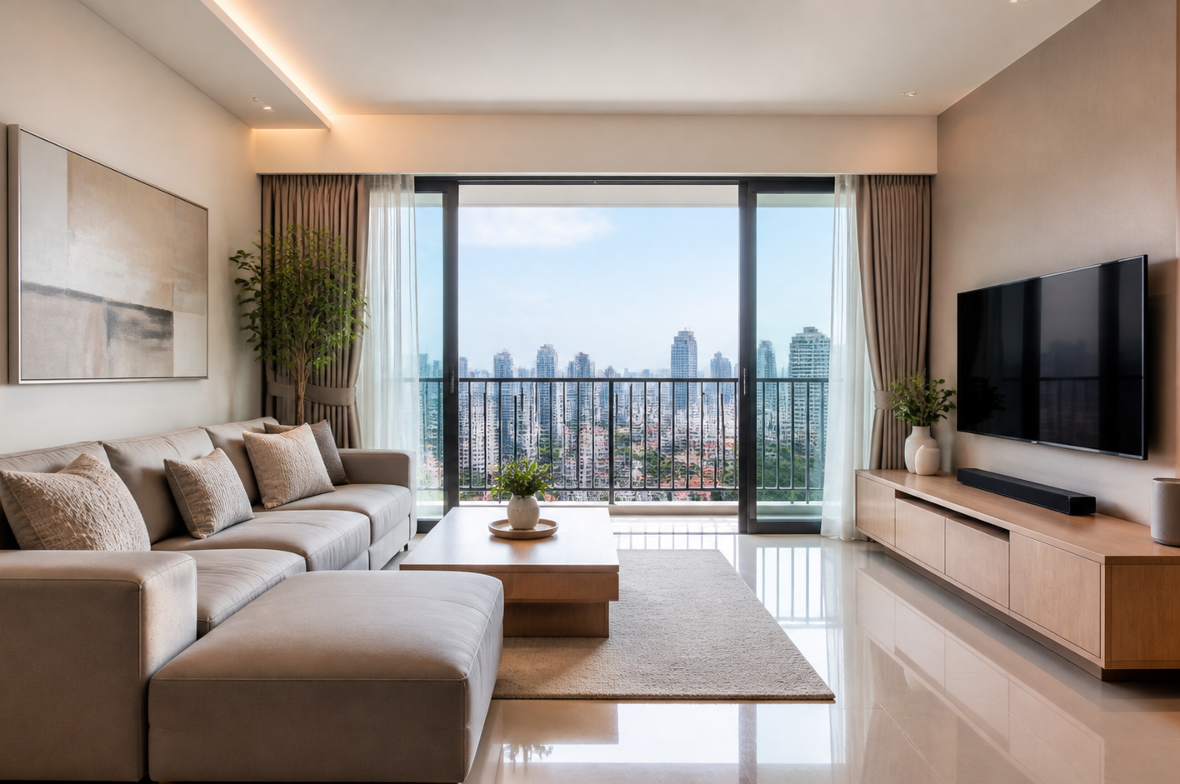
ACTIVITY 6 · ANALYSE BEFORE CAPTURE
Visual Brief and Reference
1
What attracts attention first?
2
Which light, angle and composition choices are visible?
3
What could fail technically or ethically?
4
Which acceptance criterion does the image demonstrate?
Master Mobile Photography · TGS-2026064718
© 2026 Tertiary Infotech Academy Pte Ltd
99

Slide 100
ACTIVITY 6 · VERIFY
Acceptance Review
✓
Consent and use are recorded
✓
Portrait has credible skin tone and sharp eyes
✓
Interior verticals are controlled
✓
Five images communicate person and place
Evidence: final images · completed checklist · settings/decision log · peer feedback
Master Mobile Photography · TGS-2026064718
© 2026 Tertiary Infotech Academy Pte Ltd
100

Slide 101
CHECK YOUR UNDERSTANDING
Topic 03 Recap
1
Explain
2
Explain
3
Explain
4
Explain
Point of View
Arrange Subjects for Emotion
The Blank-Canvas Check
Orientation, Crop and Aspect Ratio
Master Mobile Photography · TGS-2026064718
© 2026 Tertiary Infotech Academy Pte Ltd
101

Slide 102
Lunch Break
45 minutes
Master Mobile Photography · TGS-2026064718
© 2026 Tertiary Infotech Academy Pte Ltd
102

Slide 103
TOPIC 04
04
Enhancing Visual Quality and Effects
Shot size · camera angle · creative capture · specialty cameras · editing · critique
Master Mobile Photography · TGS-2026064718
© 2026 Tertiary Infotech Academy Pte Ltd
103

Slide 104
K6 · K7 · A6 · A7 · PART 1
Topic 04 Roadmap
1
Shot Sizes Build a Visual Story
2
A Five-Shot Coverage Pattern
3
Camera Height and Angle
4
Perspective as an Effect
Shot Sizes Build a Visual Story
A Five-Shot Coverage Pattern
Camera Height and Angle
Perspective as an Effect
5
Portrait Mode and Depth Effects
6
Macro and Close-Up
7
Panorama
8
Panning and Motion Blur
Portrait Mode and Depth Effects
Macro and Close-Up
Panorama
Panning and Motion Blur
Master Mobile Photography · TGS-2026064718
© 2026 Tertiary Infotech Academy Pte Ltd
104

Slide 105
K6 · K7 · A6 · A7 · PART 2
Topic 04 Roadmap
1
Long Exposure and Light Painting
2
Silhouette, Reflection and Flare
3
Specialty Camera
Long Exposure and Light Painting
Silhouette, Reflection and Flare
Action Camera
4
Specialty Camera
5
Lens and Equipment Care
6
The Mobile Editing Pipeline
Lomography
Lens and Equipment Care
The Mobile Editing Pipeline
7
Tone Before Colour
8
Colour and Detail with Restraint
9
Feedback That Improves the Next Shot
Tone Before Colour
Colour and Detail with Restraint
Feedback That Improves the Next Shot
Master Mobile Photography · TGS-2026064718
© 2026 Tertiary Infotech Academy Pte Ltd
105

Slide 106
TOPIC 04 · K6 · K7 · A6 · A7
Shot Sizes Build a Visual Story
1
Extreme long establishes place
2
Long/full shows the whole subject
3
Medium shows action and relationship
4
Close and extreme close reveal emotion or detail
Extreme long establishes place
Long/full shows the whole subject
Medium shows action and relationship
Close and extreme close reveal emotion or detail
Master Mobile Photography · TGS-2026064718
© 2026 Tertiary Infotech Academy Pte Ltd
106

Slide 107
TOPIC 04 · CONCEPT
A Five-Shot Coverage Pattern
1
2
3
4
5
▶
▶
▶
▶
Establishing wide
Medium action
Close-up detail
Reaction or portrait
Alternative angle for edit flexibility
Master Mobile Photography · TGS-2026064718
© 2026 Tertiary Infotech Academy Pte Ltd
107

Slide 108
TOPIC 04 · K6 · K7 · A6 · A7
Camera Height and Angle
1
Eye level feels balanced
2
High angle reveals layout
3
Low angle gives presence
4
Bird's-eye and worm's-eye create graphic views
Eye level feels balanced
High angle reveals layout
Low angle gives presence
Bird's-eye and worm's-eye create graphic views
Master Mobile Photography · TGS-2026064718
© 2026 Tertiary Infotech Academy Pte Ltd
108

Slide 109
TOPIC 04 · K6 · K7 · A6 · A7
Perspective as an Effect
1
Get close for exaggerated foreground
2
Step back for more natural proportions
3
Tilt only when the instability is intentional
4
Keep verticals straight for property and product work
Get close for exaggerated foreground
Step back for more natural proportions
Tilt only when the instability is intentional
Keep verticals straight for property and product work
Master Mobile Photography · TGS-2026064718
© 2026 Tertiary Infotech Academy Pte Ltd
109

Slide 110
TOPIC 04 · K6 · K7 · A6 · A7
Portrait Mode and Depth Effects
1
Separate subject from background
2
Keep edges away from busy textures
3
Use sufficient light
4
Inspect hair, glasses, fingers and foreground errors
Separate subject from background
Keep edges away from busy textures
Use sufficient light
Inspect hair, glasses, fingers and foreground errors
Master Mobile Photography · TGS-2026064718
© 2026 Tertiary Infotech Academy Pte Ltd
110

Slide 111
TOPIC 04 · K6 · K7 · A6 · A7
Macro and Close-Up
1
Stabilise the phone
2
Find the minimum focus distance
3
Focus on the most informative detail
4
Use side light for texture
Stabilise the phone
Find the minimum focus distance
Focus on the most informative detail
Use side light for texture
Master Mobile Photography · TGS-2026064718
© 2026 Tertiary Infotech Academy Pte Ltd
111

Slide 112
TOPIC 04 · K6 · K7 · A6 · A7
Panorama
1
Lock a stable stance and level horizon
2
Sweep slowly around the phone
3
Avoid subjects crossing the seam
4
Review joins and bent lines before leaving
Lock a stable stance and level horizon
Sweep slowly around the phone
Avoid subjects crossing the seam
Review joins and bent lines before leaving
Master Mobile Photography · TGS-2026064718
© 2026 Tertiary Infotech Academy Pte Ltd
112

Slide 113
TOPIC 04 · K6 · K7 · A6 · A7
Panning and Motion Blur
1
Match the subject's direction
2
Begin tracking before release
3
Continue after capture
4
Choose a background that shows motion
Match the subject's direction
Begin tracking before release
Continue after capture
Choose a background that shows motion
Master Mobile Photography · TGS-2026064718
© 2026 Tertiary Infotech Academy Pte Ltd
113

Slide 114
TOPIC 04 · K6 · K7 · A6 · A7
Long Exposure and Light Painting
1
Mount the phone
2
Reduce ambient brightness or use an ND filter
3
Trigger without touching
4
Keep light movement controlled and safe
Mount the phone
Reduce ambient brightness or use an ND filter
Trigger without touching
Keep light movement controlled and safe
Master Mobile Photography · TGS-2026064718
© 2026 Tertiary Infotech Academy Pte Ltd
114

Slide 115
TOPIC 04 · K6 · K7 · A6 · A7
Silhouette, Reflection and Flare
1
Expose for the bright background to make a silhouette
2
Change angle to control reflected detail
3
Shade the lens when flare reduces contrast
4
Use effects intentionally—not by accident
Expose for the bright background to make a silhouette
Change angle to control reflected detail
Shade the lens when flare reduces contrast
Use effects intentionally—not by accident
Master Mobile Photography · TGS-2026064718
© 2026 Tertiary Infotech Academy Pte Ltd
115

Slide 116
TOPIC 04 · K6 · K7 · A6 · A7
Specialty Camera: Action Camera
1
Small and mountable
2
Protective housings support difficult environments
3
Wide view captures context and movement
4
Mounts must be load-rated and secure
Small and mountable
Protective housings support difficult environments
Wide view captures context and movement
Mounts must be load-rated and secure
Master Mobile Photography · TGS-2026064718
© 2026 Tertiary Infotech Academy Pte Ltd
116

Slide 117
TOPIC 04 · K6 · K7 · A6 · A7
Specialty Camera: Lomography
1
Simple optics may create vignette, blur or light leaks
2
The result is an aesthetic choice
3
Unpredictability can suit candid work
4
Do not confuse an effect with technical failure
Simple optics may create vignette, blur or light leaks
The result is an aesthetic choice
Unpredictability can suit candid work
Do not confuse an effect with technical failure
Master Mobile Photography · TGS-2026064718
© 2026 Tertiary Infotech Academy Pte Ltd
117

Slide 118
TOPIC 04 · K6 · K7 · A6 · A7
Lens and Equipment Care
1
Use a blower or microfibre cloth
2
Avoid touching optical surfaces
3
Store dry in a protective case
4
Check condensation, caps and mount wear
Use a blower or microfibre cloth
Avoid touching optical surfaces
Store dry in a protective case
Check condensation, caps and mount wear
Master Mobile Photography · TGS-2026064718
© 2026 Tertiary Infotech Academy Pte Ltd
118

Slide 119
TOPIC 04 · CONCEPT
The Mobile Editing Pipeline
1
2
3
4
▶
▶
▶
Select the strongest frame
Crop and straighten
Balance exposure and tone
Correct colour, refine detail and export
Master Mobile Photography · TGS-2026064718
© 2026 Tertiary Infotech Academy Pte Ltd
119

Slide 120
TOPIC 04 · K6 · K7 · A6 · A7
Tone Before Colour
1
Set overall exposure
2
Recover highlights and open shadows
3
Use contrast to shape—not crush—the image
4
Check black and white points
Set overall exposure
Recover highlights and open shadows
Use contrast to shape—not crush—the image
Check black and white points
Master Mobile Photography · TGS-2026064718
© 2026 Tertiary Infotech Academy Pte Ltd
120

Slide 121
TOPIC 04 · K6 · K7 · A6 · A7
Colour and Detail with Restraint
1
Correct white balance before creative grading
2
Use saturation selectively
3
Sharpen lightly at final size
4
Avoid halos, waxy noise reduction and fake HDR
Correct white balance before creative grading
Use saturation selectively
Sharpen lightly at final size
Avoid halos, waxy noise reduction and fake HDR
Master Mobile Photography · TGS-2026064718
© 2026 Tertiary Infotech Academy Pte Ltd
121

Slide 122
TOPIC 04 · CONCEPT
Feedback That Improves the Next Shot
1
2
3
4
▶
▶
▶
Describe what is visible
Connect it to the brief
Identify one cause, not a vague dislike
Recommend a specific camera position, setting or timing change
Master Mobile Photography · TGS-2026064718
© 2026 Tertiary Infotech Academy Pte Ltd
122

Slide 123
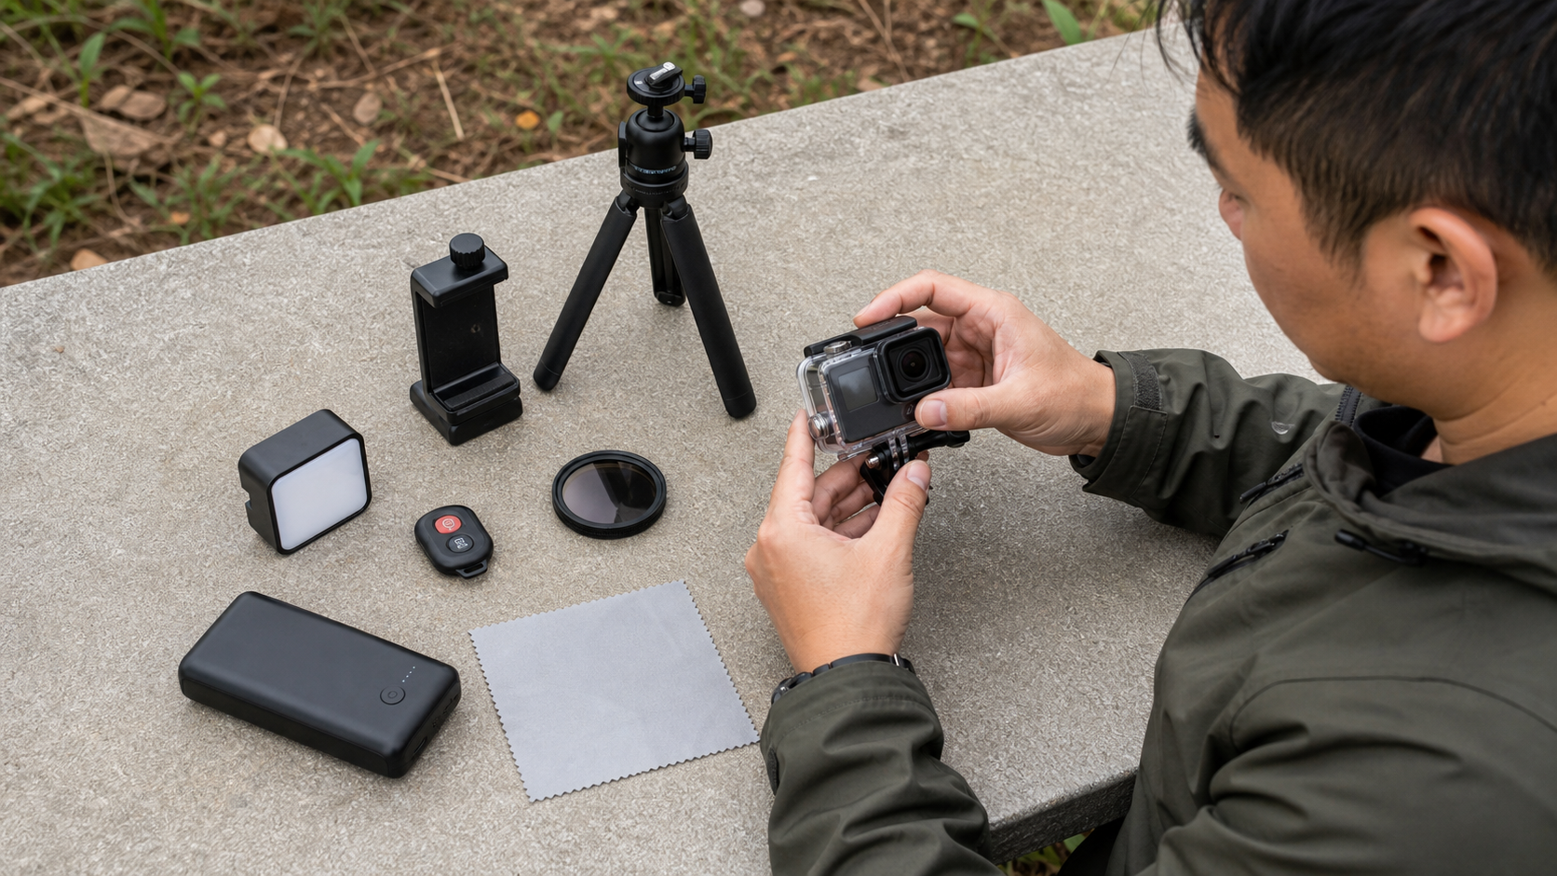
TOPIC 04 · REAL-USE-CASE ACTIVITY
Select and Mount Specialty Camera Equipment
ACTIVITY 7
An outdoor education provider needs a safe action sequence and asks whether a phone, action camera or creative toy-camera look is appropriate.
YOU'LL PRODUCE
Equipment decision, mounting inspection, five-shot action sequence and feedback note
Full procedures: Learner Guide and Activity folder
A2 · A3 · A7 · Smartphone, action camera/housing or simulator, rated mount, safety tether
Master Mobile Photography · TGS-2026064718
© 2026 Tertiary Infotech Academy Pte Ltd
123

Slide 124
ACTIVITY 7 · ANALYSE BEFORE CAPTURE
Visual Brief and Reference
1
What attracts attention first?
2
Which light, angle and composition choices are visible?
3
What could fail technically or ethically?
4
Which acceptance criterion does the image demonstrate?
Master Mobile Photography · TGS-2026064718
© 2026 Tertiary Infotech Academy Pte Ltd
124

Slide 125
ACTIVITY 7 · VERIFY
Acceptance Review
✓
Equipment choice is justified
✓
Mount and tether pass inspection
✓
Five-shot sequence covers the action
✓
Feedback links an observable defect to a specific correction
Evidence: final images · completed checklist · settings/decision log · peer feedback
Master Mobile Photography · TGS-2026064718
© 2026 Tertiary Infotech Academy Pte Ltd
125

Slide 126
TOPIC 04 · REAL-USE-CASE ACTIVITY
Edit and Deliver a Tourism Campaign Set
ACTIVITY 8
A local travel business needs six consistent photographs for a web page, square social post and vertical story.
YOU'LL PRODUCE
Six-image final set, before/after comparisons, export matrix and critique record
Full procedures: Learner Guide and Activity folder
A6 · A7 · Built-in editor, Lightroom Mobile or Snapseed; file manager/cloud folder
Master Mobile Photography · TGS-2026064718
© 2026 Tertiary Infotech Academy Pte Ltd
126

Slide 127
ACTIVITY 8 · ANALYSE BEFORE CAPTURE
Visual Brief and Reference
1
What attracts attention first?
2
Which light, angle and composition choices are visible?
3
What could fail technically or ethically?
4
Which acceptance criterion does the image demonstrate?
Master Mobile Photography · TGS-2026064718
© 2026 Tertiary Infotech Academy Pte Ltd
127

Slide 128
ACTIVITY 8 · VERIFY
Acceptance Review
✓
Six images are visually consistent
✓
Edits retain natural texture and colour
✓
Exports match the named channels
✓
Critique contains a specific evidence-based improvement
Evidence: final images · completed checklist · settings/decision log · peer feedback
Master Mobile Photography · TGS-2026064718
© 2026 Tertiary Infotech Academy Pte Ltd
128

Slide 129
CHECK YOUR UNDERSTANDING
Topic 04 Recap
1
Explain
2
Explain
3
Explain
4
Explain
The Mobile Editing Pipeline
Tone Before Colour
Colour and Detail with Restraint
Feedback That Improves the Next Shot
Master Mobile Photography · TGS-2026064718
© 2026 Tertiary Infotech Academy Pte Ltd
129

Slide 130
WRAP-UP
Professional Mobile Photography Workflow
Plan · inspect · capture · review · edit · deliver
Master Mobile Photography · TGS-2026064718
© 2026 Tertiary Infotech Academy Pte Ltd
130

Slide 131
CAPSTONE
The Complete Workflow
1
2
3
4
5
▶
▶
▶
▶
Interpret brief and plan
Inspect gear and location
Control light, focus and exposure
Compose and capture variations
Edit, export and critique
Master Mobile Photography · TGS-2026064718
© 2026 Tertiary Infotech Academy Pte Ltd
131

Slide 132
LEARNING OUTCOMES
What You Can Now Do
1
LO1
2
LO2
3
LO3
4
LO4
Set up a mobile phone camera for shooting and interpret a shot plan.
Perform basic mobile photography while meeting safety requirements.
Apply framing and composition techniques using a mobile phone camera.
Enhance visual quality and effects using capture and editing controls.
Master Mobile Photography · TGS-2026064718
© 2026 Tertiary Infotech Academy Pte Ltd
132

Slide 133
QUALITY GATE
Professional Self-Critique
Image craft
Fitness for use
1
What is the intended subject and message?
1
Does the image meet the brief?
2
Where does the eye go first?
2
Are privacy and safety protected?
3
Are focus, exposure and colour controlled?
3
Is the edit natural and consistent?
4
Is the composition deliberate?
4
What one change improves the next capture?
Master Mobile Photography · TGS-2026064718
© 2026 Tertiary Infotech Academy Pte Ltd
133

Slide 134
APPROVED RESEARCH SOURCES
Source and Evidence Register
1
Course page · www.tertiarycourses.com.sg
2
Adobe smartphone photography guide · www.adobe.com
3
Digital Photography School beginner tips · digital-photography-school.com
4
TIU Mobile Photography Composition Techniques · lecture-notes.tiu.edu.iq
5
Techformatics mobile photography skills guide · techformatics.com
6
Full URLs and coverage notes are in the Learner Guide source register
Master Mobile Photography · TGS-2026064718
© 2026 Tertiary Infotech Academy Pte Ltd
134

Slide 135
APPROVED RESEARCH SOURCES
Additional Research and Video References
1
Aesthetics of Photography smartphone mastery · aestheticsofphotography.com
2
The School of Photography phone tips · www.theschoolofphotography.com
3
YouTube: 13 Smartphone Photography Tips & Tricks · www.youtube.com
4
YouTube supplied reference · www.youtube.com
5
YouTube supplied reference · www.youtube.com
6
Full URLs and coverage notes are in the Learner Guide source register
Master Mobile Photography · TGS-2026064718
© 2026 Tertiary Infotech Academy Pte Ltd
135

Slide 136
LMS/TMS
Courseware and Assessment on the LMS
1
Download current learner materials
2
Complete the WA then PP
3
Upload completed answers
4
Contact enquiry@tertiaryinfotech.com for support
Master Mobile Photography · TGS-2026064718
© 2026 Tertiary Infotech Academy Pte Ltd
136

Slide 137
ASSESSMENT
Assessment Reminder
WA
PP
1
Written Assessment
1
Practical Performance
2
8 open-ended questions
2
3 tasks
3
K1–K8
3
A1–A7
4
90 minutes
4
90 minutes
Master Mobile Photography · TGS-2026064718
© 2026 Tertiary Infotech Academy Pte Ltd
137

Slide 138
ON ASSESSMENT DAY
Assessment Flow
1
2
3
4
5
▶
▶
▶
▶
TRAQOM digital attendance
Assessment digital attendance
Sit WA then PP
Submit answers on LMS
Sign Assessment Summary Record
Master Mobile Photography · TGS-2026064718
© 2026 Tertiary Infotech Academy Pte Ltd
138

Slide 139
TRAQOM · SSG
Digital Attendance (Mandatory)
1
Complete Assessment digital attendance before starting
2
Use the SSG QR code shown by the trainer
3
Submit attendance successfully
4
Ask the trainer if confirmation is not visible
Master Mobile Photography · TGS-2026064718
© 2026 Tertiary Infotech Academy Pte Ltd
139

Slide 140
MASTER MOBILE PHOTOGRAPHY
Thank You
Make the next photograph intentional: plan the story, read the light, control the frame.
Master Mobile Photography · TGS-2026064718
© 2026 Tertiary Infotech Academy Pte Ltd
140

